Slide 1

Contract-Grounded Governance and Behavioral Auditing for Sustainable Multi-Agent AI-Compute Markets
SDG 9: Industry, Innovation and Infrastructure

Slide 2
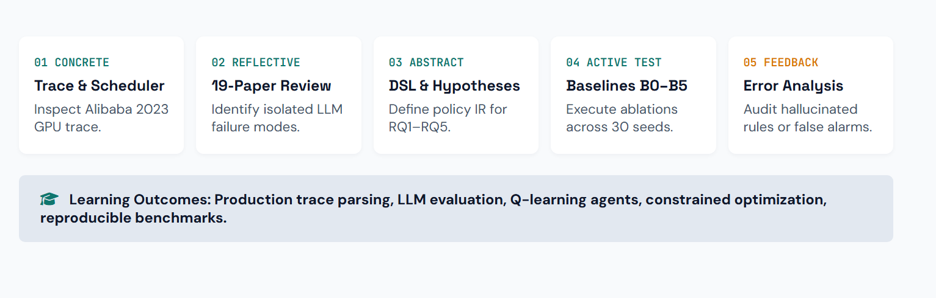
Experiential Learning – outline of tentative steps / methodology adopted (or to be adopted)

Slide 3
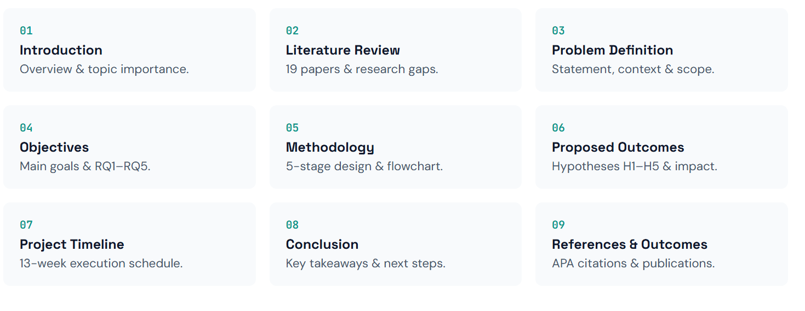
EL Phase-I
Presentation Outline
Introduction
Literature Review
Problem Definition
Objectives
Methodology
Proposed Outcomes
Timeline of the project
Conclusion
References

Slide 4
Introduction
Overview of the Topic
Modern AI services run on shared, costly GPU infrastructure. Workloads differ in hardware needs, urgency and flexibility.
When several providers compete to serve jobs, prices, user preferences, contractual guarantees, availability and environmental limits all interact.
PACT-Compute is a fully software-based, trace-driven simulation of a multi-provider GPU marketplace.
One governance loop connects everything: Agreement → Protocol → Market Interaction → Allocation Trace → Independent Audit → Explanation.
Three components
Contract Compiler: Turns natural-language service agreements into machine-checkable rules.
Multi-Agent Market + Carbon-aware scheduler: Buyers and providers negotiate GPU capacity under those rules.
Behavior Auditor: Reconstructs agent strategies as finite-state machines and flags violations.
Importance of the Topic
LLM-generated specifications can omit exceptions, invent thresholds or change units, so fluent output is not correct output.
High prices alone do not prove collusion, so auditing needs interpretable evidence.
Carbon-aware scheduling trades off against deadlines, throughput and fairness.
These three lines of research are usually evaluated separately, under different assumptions.

Slide 5
Literature Review
SI. No | Paper Title | Citation | Published | Paper Summary | Gaps
1. | Extracting Formal Specifications from Documents Using LLMs for Automated Testing | Li et al. | 2025 | Investigates the use of large language models (LLMs) to convert document-based requirements into formal specifications that can support automated testing. | Extracted specifications may contain omissions or ambiguities. Further work is needed to connect source evidence, validated policy rules, and runtime enforcement in a GPU marketplace.
2. | Layer-Condensed KV Cache for Efficient Inference of Large Language Models | Wu, Haoyi; Tu, Kewei | 2024 | Explores LLM-based agents for simulating and optimizing policies that allocate scarce resources, providing a foundation for agent-based resource-allocation experiments. | The proposed project can investigate how resource allocation agents interact with explicit service-level agreements (SLAs), carbon-aware scheduling, and behavioral auditing within a unified compute-market environment.
3. | Algorithmic Collusion in Dynamic Pricing with Deep Reinforcement Learning | Wang, Luning; Li, Shiyao; Ning, Xuefei; Yuan, Zhihang; Yan, Shengen; Dai, Guohao; Wang, Yu (ENLSP/NeurIPS Workshop | 2024 | Studies the emergence of potentially collusive pricing behavior among agents using deep reinforcement learning in dynamic pricing environments. | Findings from pricing environments may not directly transfer to GPU compute markets. Auditing should account for capacity constraints, legitimate scarcity, and evidence-based explanations rather than treating suspicious patterns as proof of collusion.

Slide 6
Literature Review
SI. No | Paper Title | Citation | Published | Paper Summary | Gaps
4. | Multi-Agent Deep Reinforcement Learning Framework for Renewable Energy-Aware Workflow Scheduling | Jayanetti et al. | 2024 | Examines multi-agent deep reinforcement learning for scheduling workflows in distributed cloud data centers. | A unified framework could further integrate contract-derived hard constraints, provider-market interactions, explicit policy validation, and post-allocation behavioral audits.
5. | TLA+-Bench: An Execution-Grounded Benchmark and Dataset for Natural-Language to TLA+ Specification Generation | Bisharat et al. | 2026 . | Presents a benchmark and dataset for evaluating the generation of TLA+ formal specifications from natural-language descriptions. | Formal-specification benchmarks do not by themselves establish end-to-end correctness for compute contracts, marketplace allocation, carbon-aware scheduling, and runtime monitoring
6. | Carbon Footprint Estimation for Computational Research | Lannelongue & Inouye | 2023 | Discusses methods and practical considerations for estimating the carbon footprint of computational research.. | Estimates depend on assumptions and input quality. GPU-market evaluations need clearly documented energy models, time-aligned carbon-intensity data, and uncertainty reporting.

Slide 7
Literature Review
SI. No | Paper Title | Citation | Published | Paper Summary | Gaps
7. | Beware of Fragmentation: Scheduling GPU-Sharing Workloads with Fragmentation Gradient Descent | Weng et al. | 2023 | Investigates GPU-sharing workload scheduling and how fragmentation affects resource utilization and proposing fragmentation | Fragmentation-aware scheduling alone does not cover natural-language SLA interpretation, multi-agent pricing behavior, etc.
8. | Alibaba Cluster Data: GPU Cluster Trace v2023 | Alibaba Cluster Data | Not Defined. | Provides GPU cluster trace data that can be used to study workload characteristics and evaluate scheduling approaches under trace-driven conditions. | Workload traces do not necessarily provide complete SLA text, market prices, buyer valuations, provider strategies, or aligned power measurements. Missing market variables must be simulated or sourced separately.

Slide 8
Problem Definition
Clear Statement of the Problem
PACT-Compute addresses the lack of a unified framework for translating natural-language GPU computing contracts into validated policies, allocating GPU resources according to contractual and carbon constraints, and auditing potentially suspicious behavior among competing market agents.
Context of the Problem
Growing demand for AI applications is increasing the need for efficient GPU resource allocation.
Existing approaches often focus on individual aspects, such as scheduling, energy efficiency, or strategic pricing.
Integrating contract validation, multi-agent market simulation, carbon-aware scheduling, and behavioral auditing remains a challenge.
Significance of Addressing the Problem
Without proper contract validation, GPU service-level agreements may be violated.
Inefficient scheduling can lead to GPU resource wastage and increased waiting times.
Unmonitored pricing strategies may enable unfair market behavior to go undetected.

Slide 9
Objectives
Main Objective
To develop PACT-Compute, an integrated framework that converts natural-language GPU contracts into validated policies and combines multi-agent resource allocation, carbon-aware scheduling, and behavioral auditing.
Specific Objectives
Extract GPU requirements, deadlines, budgets, and carbon preferences from contracts and validate them using deterministic rules.
Simulate buyer–provider interactions with different pricing and resource-allocation strategies.
Compare GPU scheduling algorithms using Alibaba GPU traces and carbon-intensity data.
Detect suspicious pricing patterns and generate evidence-based audit reports.
3. Expected Contributions to the Field
Integrates contract validation, GPU scheduling, and behavioral auditing in one framework.
Links extracted policy rules to their original contract text for traceability.
Provides reproducible comparisons of scheduling performance and estimated emissions.

Slide 10
Methodology
1. Design
Quantitative, experiment-based research approach.
Develop a software-based simulation of a multi-provider GPU-computing marketplace.
Integrate contract validation, multi-agent pricing, resource scheduling, behavioral auditing, and carbon-aware allocation.
Compare the proposed system with baseline methods.
2. Data Collection Methods
Collect GPU workload data from the Alibaba GPU Cluster Trace 2023.
Create synthetic computing-service agreements with manually reviewed labels.
Obtain electricity carbon-intensity data from public sources where accessible.
Generate simulated provider prices, buyer bids, agent interactions, and allocation logs.
3. Data Analysis Techniques
Evaluate contract extraction using precision, recall, and F1-score.
Measure job completion, waiting time, deadline compliance, and GPU utilization.
Analyze provider profit, buyer surplus, and allocation fairness.

Slide 11
Methodology
Evaluate behavioral auditing using classification metrics and false-positive rates.
Estimate energy consumption and carbon emissions.
Compare results across baseline methods and experimental scenarios.
4. Tools and Resources Used
Python: Core implementation and simulation.
LLMs: Contract extraction and evidence-based explanations.
Pydantic / JSON Schema: Policy validation.
Pandas: Dataset processing.
Tabular Q-learning: Adaptive pricing agents.
OR-Tools: Resource scheduling and optimization.
NetworkX: Finite-state behavior representation.
Streamlit: Interactive dashboard.
Matplotlib / Plotly: Performance and emissions visualization.

Slide 12
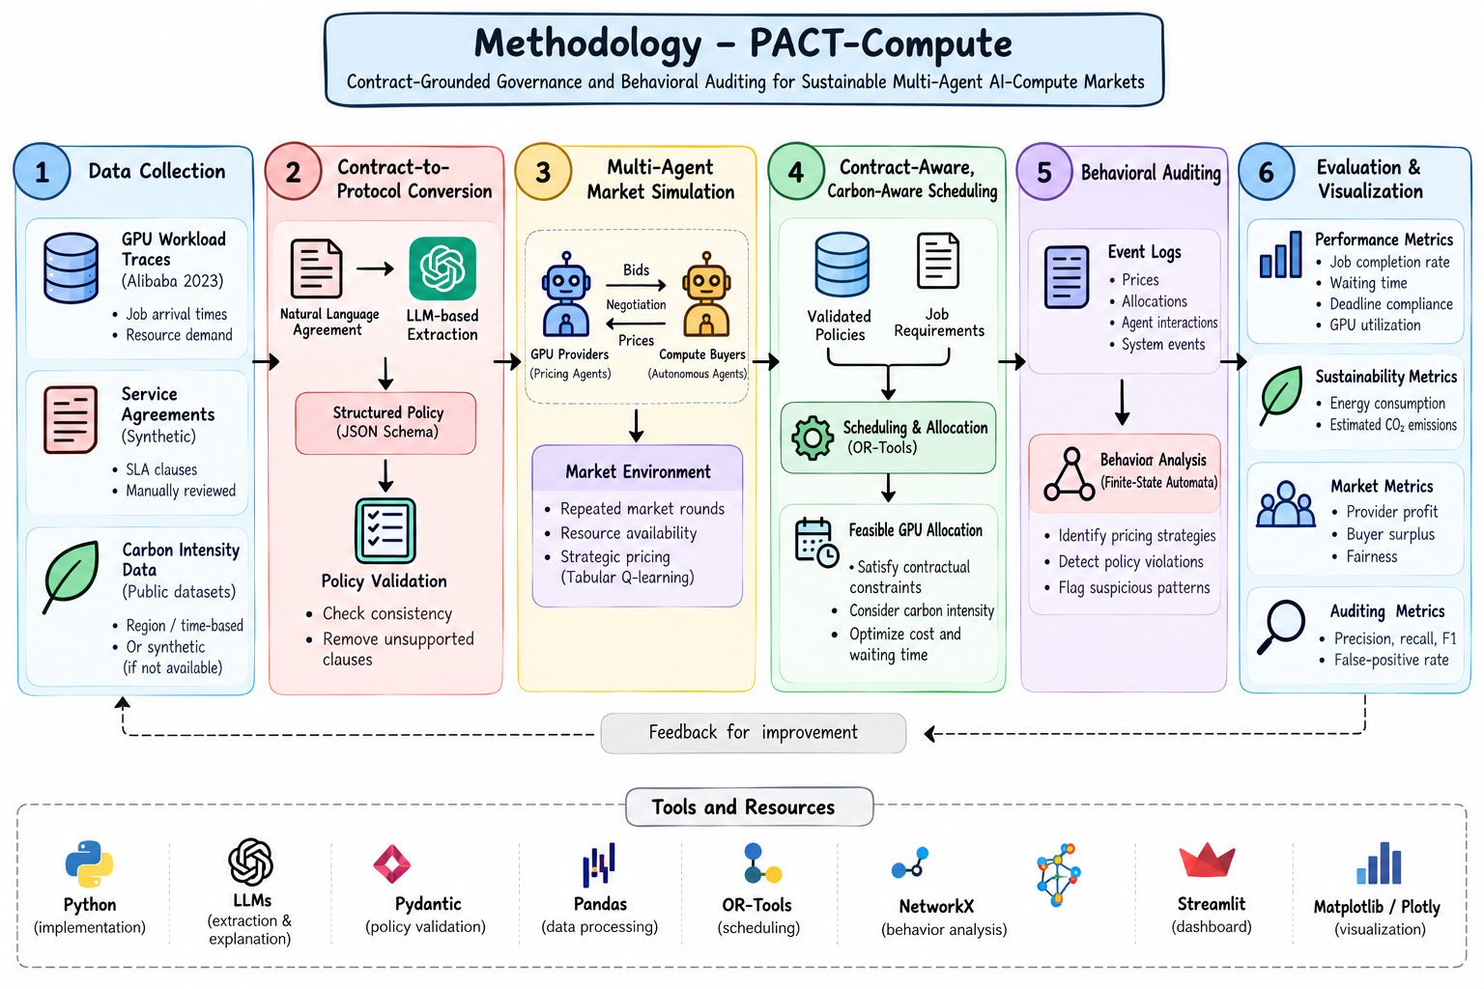
Methodology
.

Slide 13
Proposed Outcomes
1. Expected Results
Develop a functional, software-based simulation of a multi-provider GPU-computing marketplace.
Convert natural-language service agreements into structured, machine-checkable policies using LLMs.
Improve policy compliance through automated validation and runtime monitoring.
Simulate autonomous agents competing through pricing and resource allocation.
Identify suspicious pricing patterns and policy violations using finite-state behavioral auditing.
Optimize GPU allocation by balancing deadlines, cost, fairness, and estimated carbon emissions.
Evaluate the system using performance, market, auditing, and sustainability metrics.
2. Potential Impact on the Field
Enable more transparent and accountable AI-computing resource allocation.
Reduce contractual violations through automated policy enforcement.
Improve understanding of autonomous agents' pricing strategies in simulated markets.
Support sustainable computing by incorporating electricity carbon intensity into scheduling decisions.
Provide a reproducible research benchmark for evaluating compliance, efficiency, fairness, and environmental impact.
Help researchers investigate the trade-offs between economic performance and sustainability.

Slide 14
Proposed Outcomes
3. Future Research Directions
Extend the simulator to larger GPU clusters and more diverse computing workloads.
Explore advanced multi-agent reinforcement learning and pricing strategies.
Improve contract interpretation using domain-specific LLMs and larger agreement datasets.
Investigate more sophisticated automata-learning and interpretable behavioral-auditing techniques.
Integrate real-time electricity carbon-intensity data and measured GPU power consumption.
Evaluate the framework using real-world deployment data and more complex market scenarios.

Slide 15
Timeline of the project
Project Timeline Overview
Initiation Phase (Weeks 1-2)
  Define project goals and objectives.
  Identify group members and resources.
  Conduct feasibility studies.
Planning Phase (Weeks 3-4)
  Develop a detailed project plan, including tasks and timelines.
  Allocate resources and assign responsibilities.
  Create a budget plan.
Execution Phase (Weeks 5-10)
  Begin project work according to the project plan.
  Hold regular team meetings to monitor progress.
  Implement communication strategies with group members.
Closure Phase (Weeks 11-13)
  Complete final deliverables and obtain panel approval.
  Present in project review and document lessons learned.
  Formally close the project.

Slide 16
Conclusion
1. Summary of Key Points
Integrates contract-to-protocol conversion, multi-agent market simulation, and behavioral auditing.
Enforces service agreements through machine-checkable policies and automated verification.
Optimizes GPU resource allocation by considering cost, deadlines, fairness, and carbon emissions.
Evaluates system performance through reproducible simulations and measurable metrics.
2. Final Thoughts
PACT-Compute aims to make AI-computing markets more transparent, compliant, interpretable, and sustainable.
The project connects autonomous agent behavior with contractual governance and environmental responsibility.
3. Call to Action / Next Steps
Collect and preprocess GPU workload and carbon-intensity datasets.
Implement the contract compiler, market simulator, scheduler, and behavioral auditor.
Integrate the components into an interactive dashboard.
Test against baseline methods and evaluate performance, compliance, fairness, and emissions.
Analyze the results, document limitations, and identify opportunities for future research.

Slide 17
References
Li, H., Dong, Z., Wang, S., Zhang, H., Shen, L., Peng, X., & She, D. (2025). Extracting formal specifications from documents using LLMs for automated testing. arXiv. https://arxiv.org/abs/2504.01294
Ji, J., Li, Y., Liu, H., Du, Z., Wei, Z., Qi, Q., Shen, W., & Lin, Y. (2024). SRAP-Agent: Simulating and optimizing scarce resource allocation policy with LLM-based agent. Findings of the Association for Computational Linguistics: EMNLP 2024.
Deng, S., Schiffer, M., & Bichler, M. (2024). Algorithmic collusion in dynamic pricing with deep reinforcement learning. arXiv. https://arxiv.org/abs/2406.02437
Jayanetti, A., Halgamuge, S., & Buyya, R. (2024). Multi-agent deep reinforcement learning framework for renewable energy-aware workflow scheduling on distributed cloud data centers. IEEE Transactions on Parallel and Distributed Systems, 35(4), 604–615.
Bisharat, A., et al. (2026). TLA+-Bench: An execution-grounded benchmark and dataset for natural-language to TLA+ specification generation. arXiv. https://arxiv.org/abs/2607.23425
Lannelongue, L., & Inouye, M. (2023). Carbon footprint estimation for computational research. Nature Reviews Methods Primers, 3, Article 9.
Weng, Q., Yang, L., Yu, Y., Wang, W., Tang, X., Yang, G., & Zhang, L. (2023). Beware of fragmentation: Scheduling GPU-sharing workloads with fragmentation gradient descent. Proceedings of the USENIX Annual Technical Conference (USENIX ATC 2023).
Alibaba Cluster Data. (n.d.). GPU cluster trace v2023. https://github.com/alibaba/clusterdata/tree/master/cluster-trace-gpu-v2023
Electricity Maps. (n.d.). Carbon intensity API documentation. https://app.electricitymaps.com/docs/reference/carbon-intensity
Green Algorithms. (n.d.). Green Algorithms: Computational carbon footprint estimation. https://www.green-algorithms.org/

Slide 18
Expected Outcome by the end of First Year
EL should aim for tangible results in one of the following forms:
Patent Filing: If your prototype shows novel functionality or an innovative process, file for a patent. Steps include drafting a patent description, claims, and conducting a prior art search.
Journal Publication: Write a comprehensive paper detailing the methodology, prototype design, testing, and results. Submit to journals related to manufacturing technology, engineering design, or industrial innovation.
Conference Publication: Prepare an abstract or full paper for submission to conferences. Present your prototype development, key findings, and future research possibilities (Paper to be drafted as per IEEE format. Format will be shared later on)
Research Proposal: Propose extending the research into a larger project, securing funding for mass production, or applying the process to different industries. Include objectives, proposed methodology, expected impacts, and a budget estimate.

Slide 19


